Slide 1
Your Safety, Your Say and Young Voices in Policing
Survey results summary, January 2025
FOIA Open

Slide 2
About the surveys
The Your Safety, Your Say survey was launched in November 2023 on the Commonplace Community Engagement Platform. The Young Voices in Policing survey was launched in August 2024 to improve engagement levels among young people.
The summary survey results included in the presentation attached to this paper cover the period February 2, 2024, to January 7, 2025.
A total of 1,915 people contributed to the surveys in this period.
A sample size of 385 participants would be required to give statistically significant results, with a margin of error of +/- 5%.

Slide 3
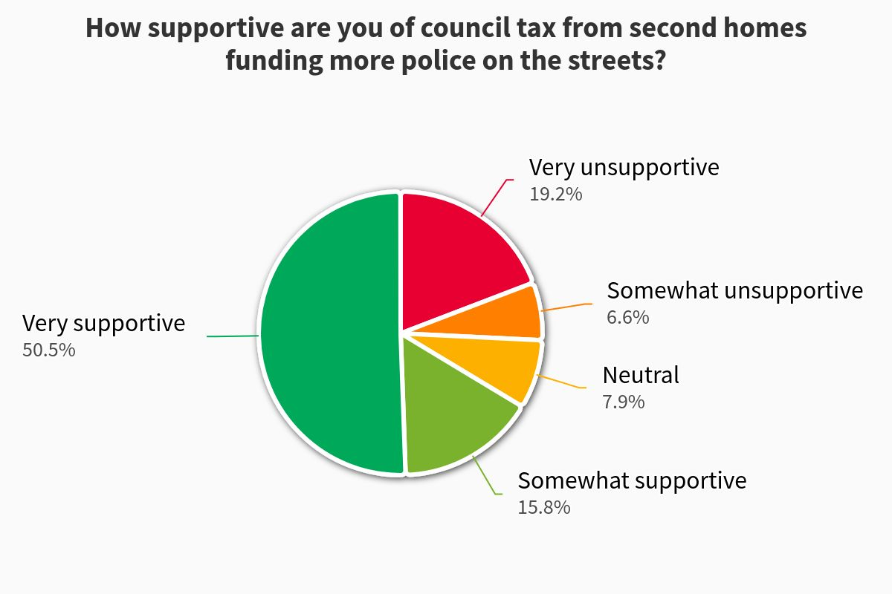
Your Safety, Your Say – second homes
This was question was added in response to a new funding stream from second homes taxation.
Levels of support were increased among older age groups and people who had been affected by crime.

Slide 4
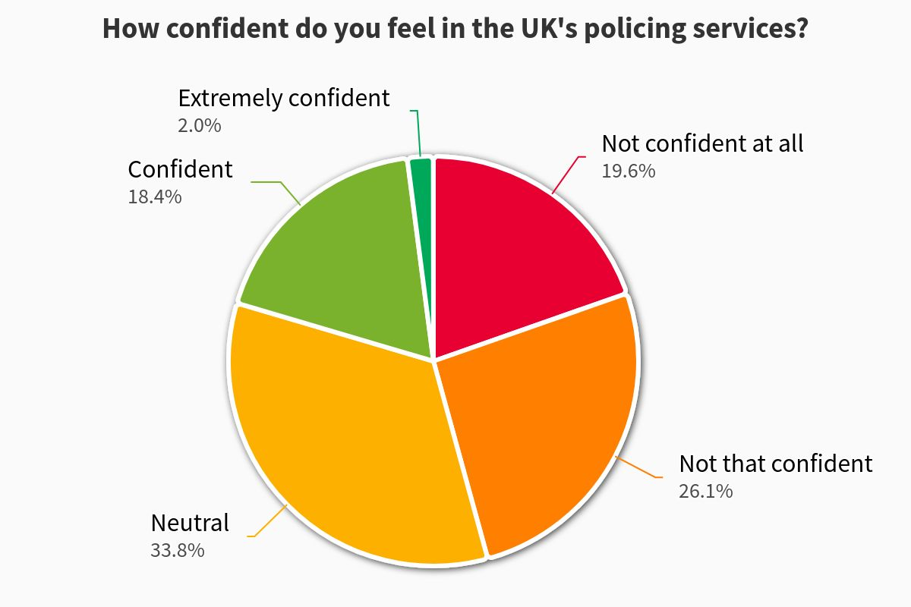
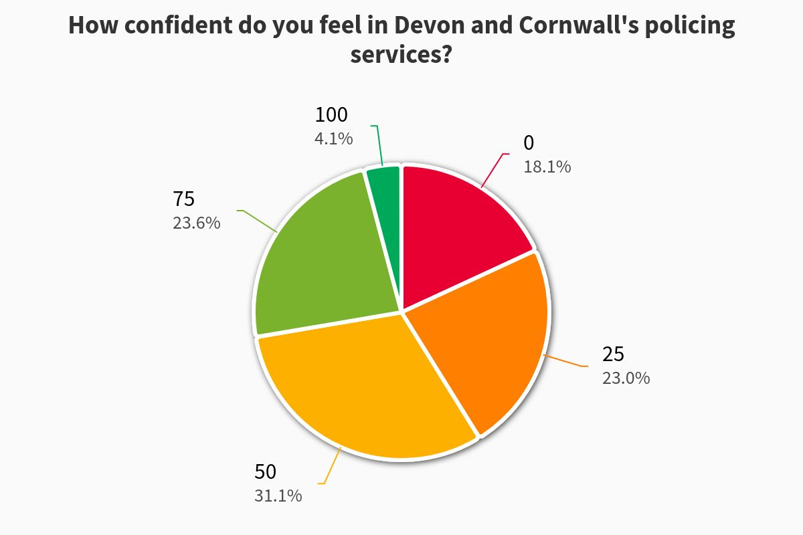
Your Safety, Your Say – confidence
Consistent with previous years’ surveys, levels of confidence in Devon & Cornwall Police remain higher than those in UK policing services.
Levels of confidence in both UK and DCP services were broadly similar in the 2023-24.

Slide 5
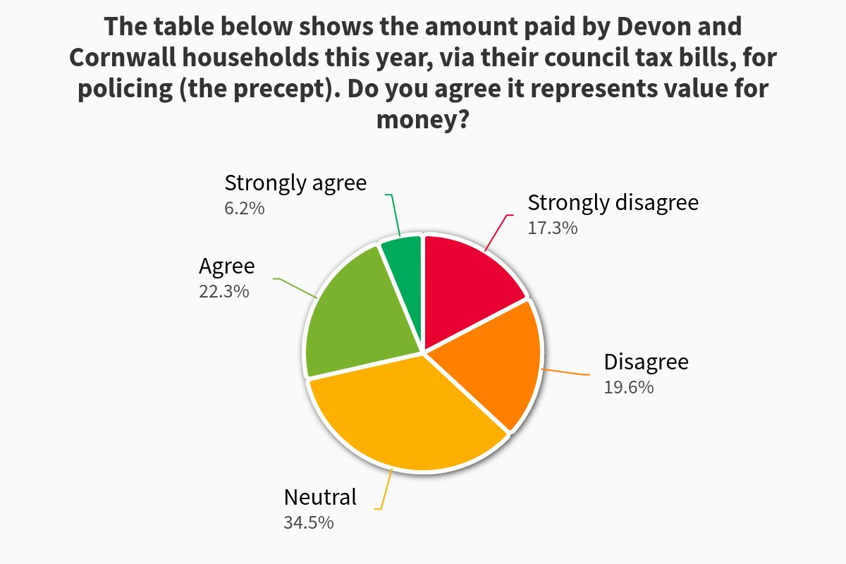
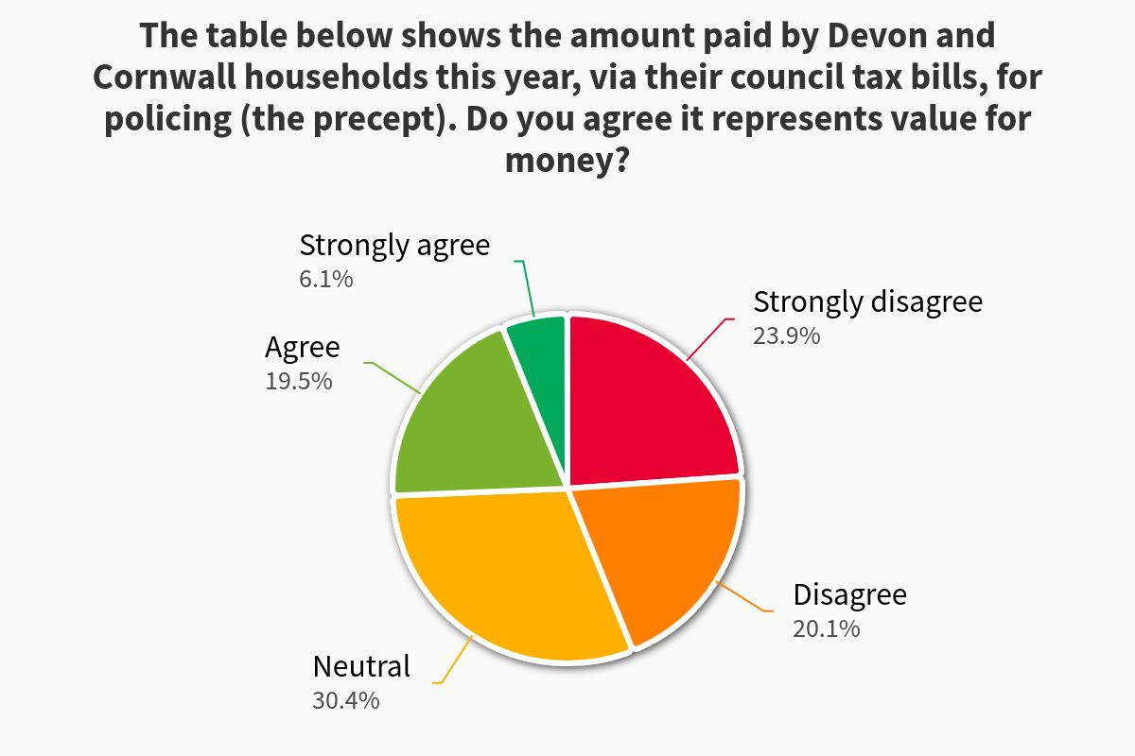
Your Safety, Your Say – precept value
2025
2024
Respondents have become more likely to agree that precept levels represented value for money since the survey began.

Slide 6
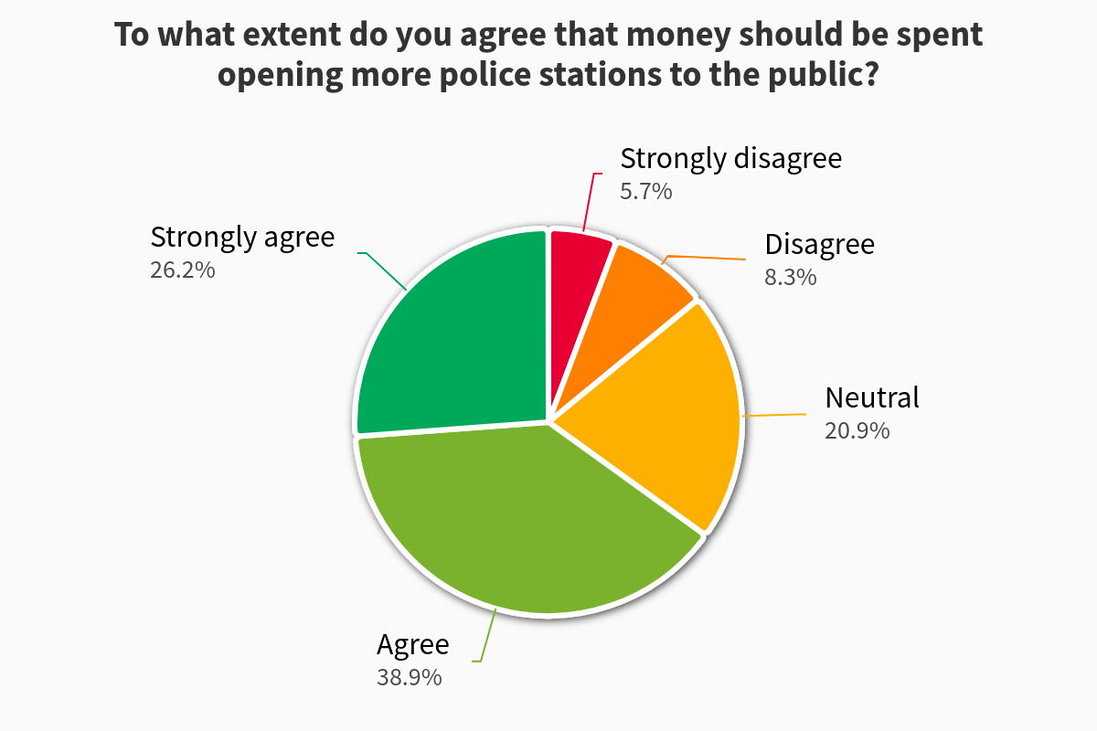
Your Safety, Your Say – police enquiry offices
Levels of support for the project to invest in police enquiry offices has remained consistently high for every year this question has been asked.

Slide 7
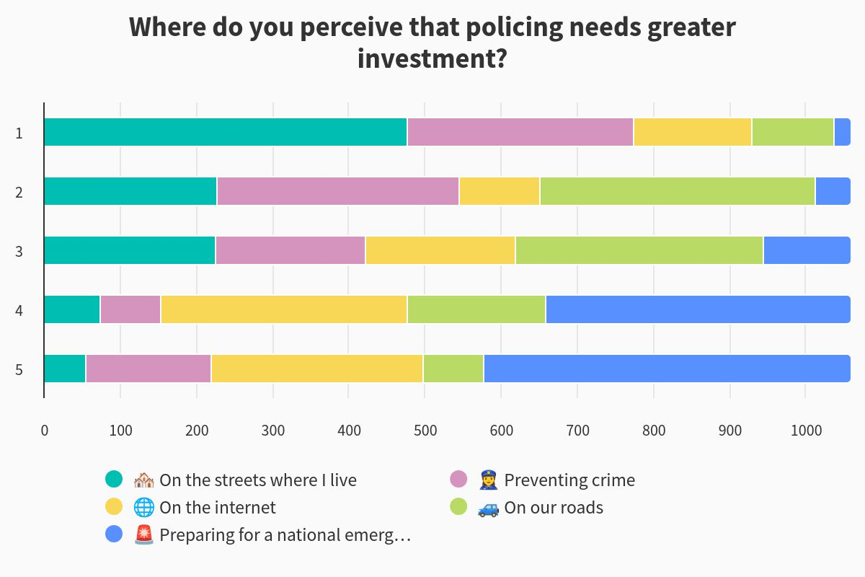
Your Safety, Your Say – policing priorities
This question asked participants to rank five different policing areas in terms of priority.
Five years ago ‘On the Internet’ was the lowest ranked priority.

Slide 8
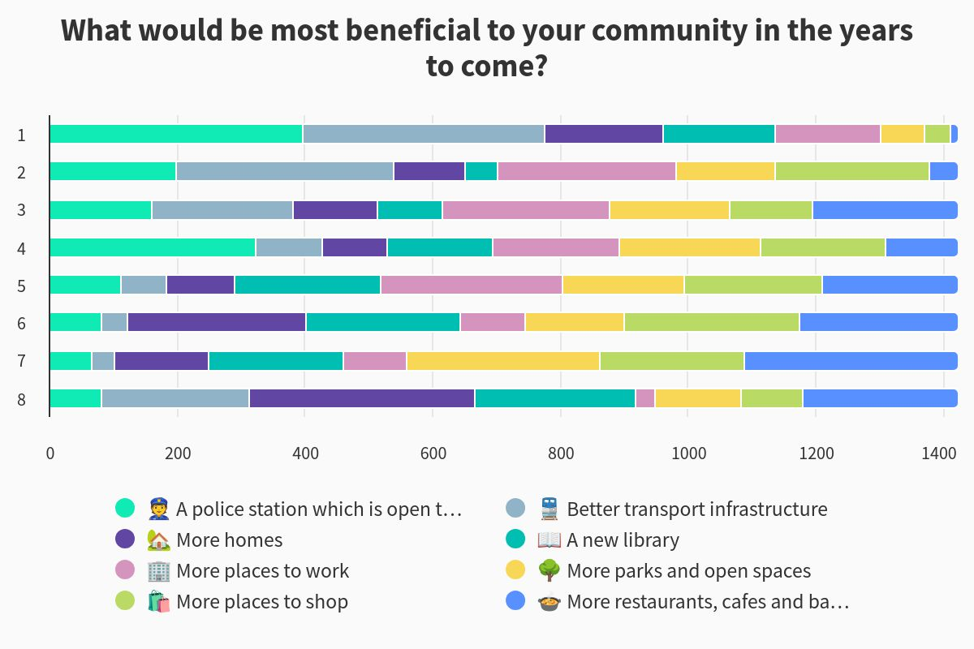
Your Safety, Your Say – police investment in context
‘Police stations which are open to the public’ gained similar levels of support to ‘better transport infrastructure’ when it came to future community wishes/requirements.

Slide 9
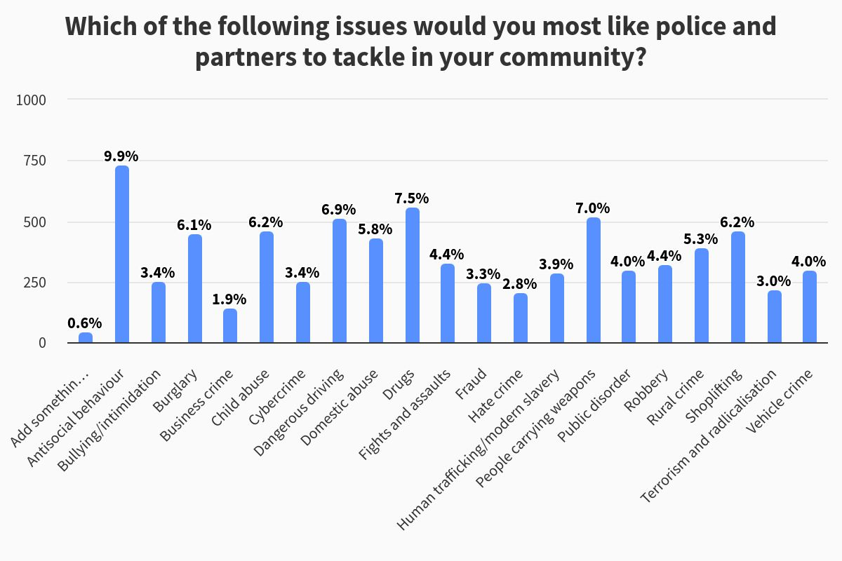
Your Safety, Your Say – policing priorities
Antisocial behaviour remains the policing/crime/societal issue which communities’ most want tackled – this is consistent with several years’ results.
Concerns about violent and drug related crimes rose considerably when participants completed the survey in the summer months.

Slide 10
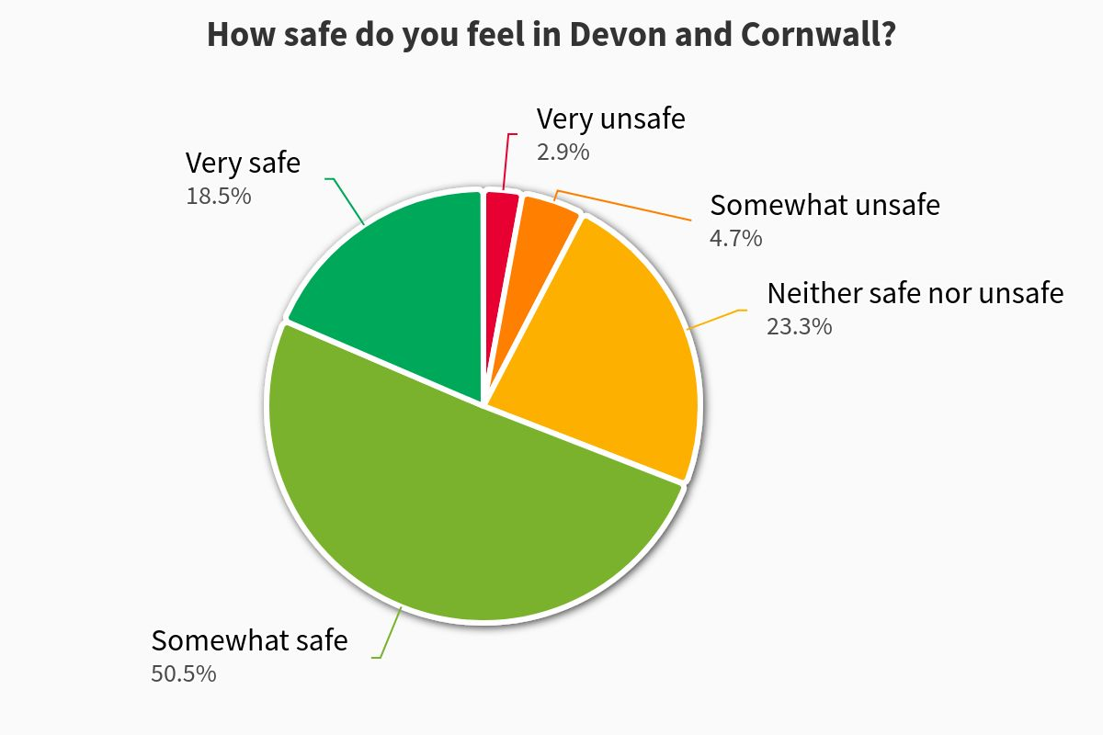
Young Voices in Policing – feelings of safety

Slide 11
Young Voices in Policing – confidence

Slide 12
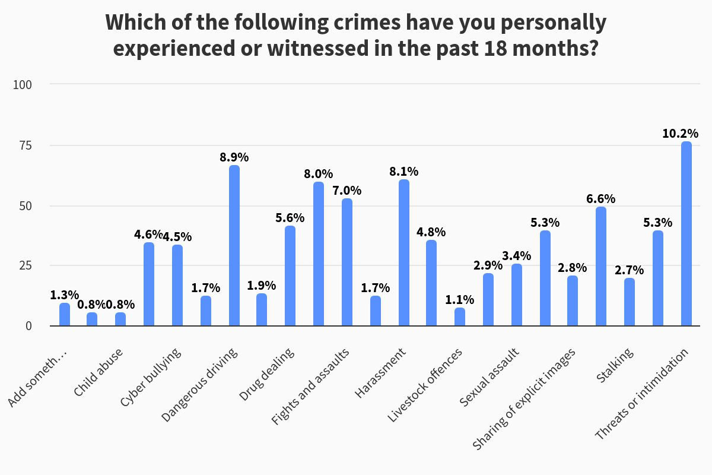
Young Voices in Policing – crime exposure

Slide 13
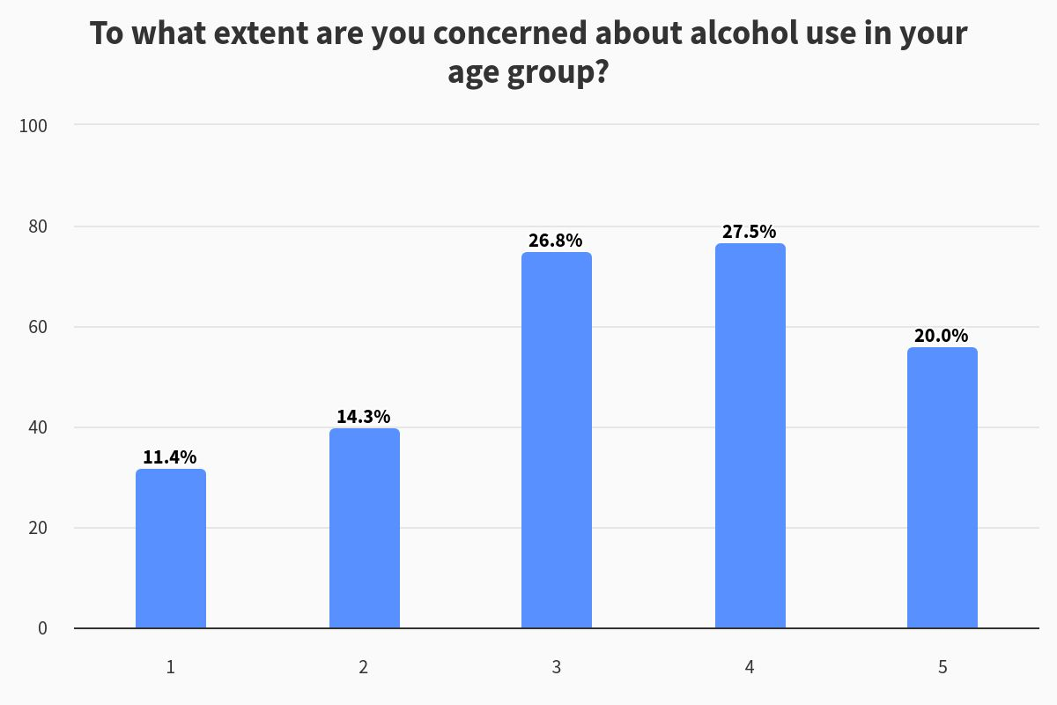
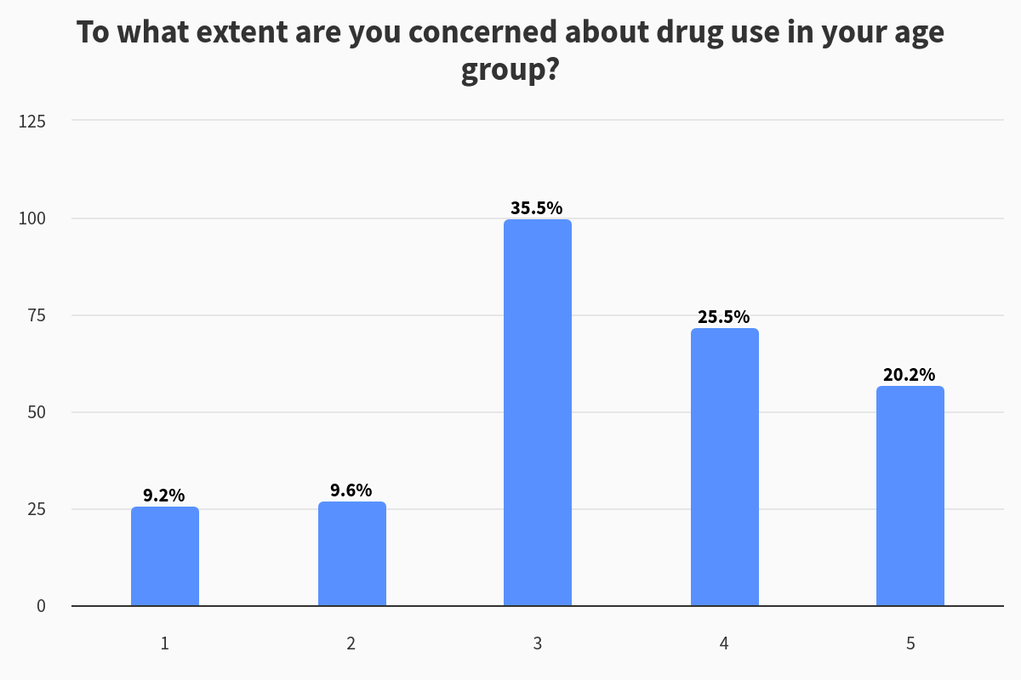
Young Voices in Policing – drug and alcohol misuse

Slide 14
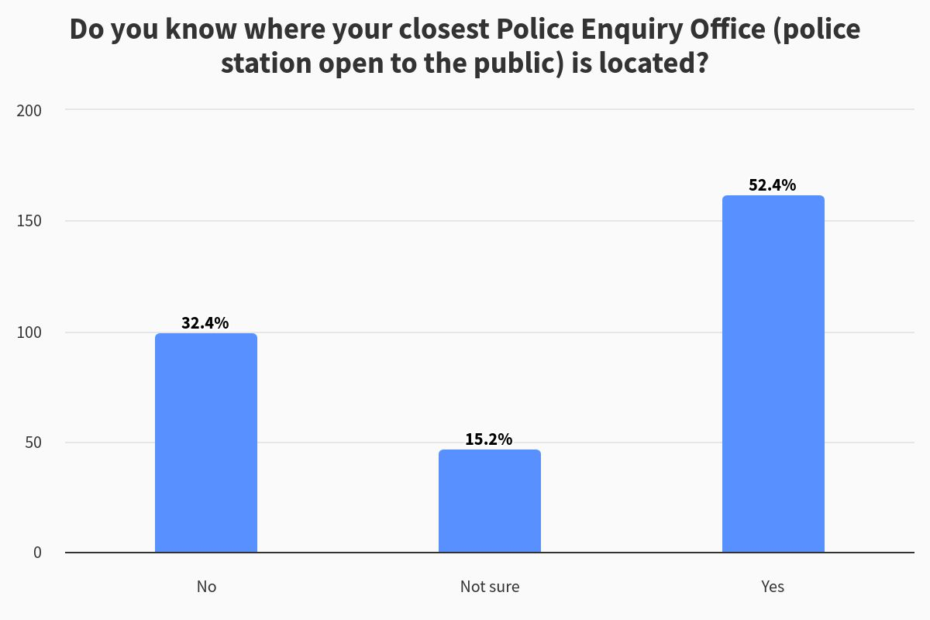
Young Voices in Policing – PEO awareness

Slide 15
Any questions?

